Slide 1
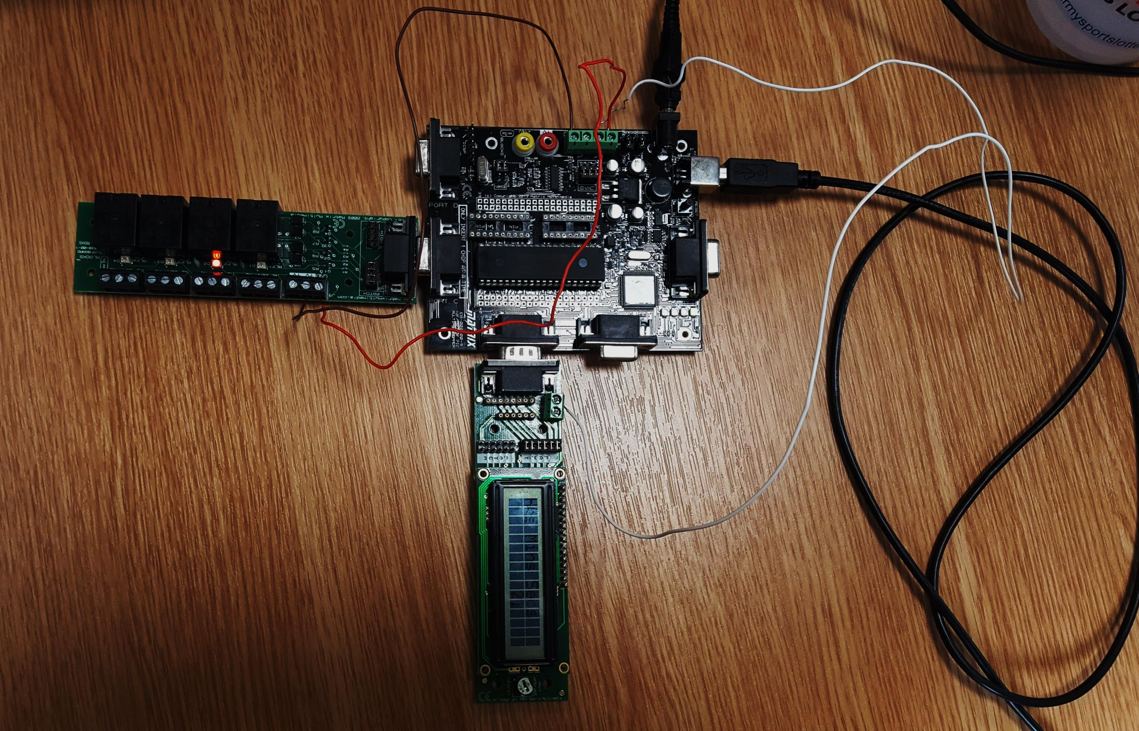

Making a 24hr
Timer

Slide 2
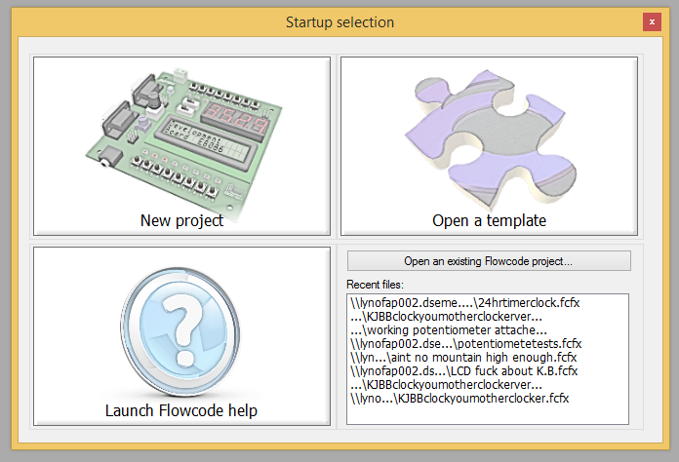
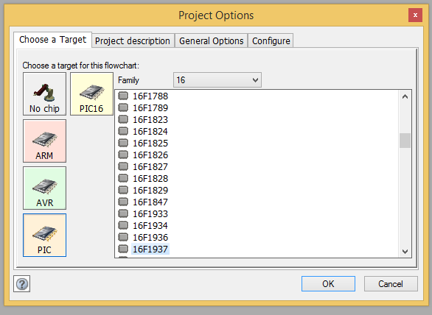
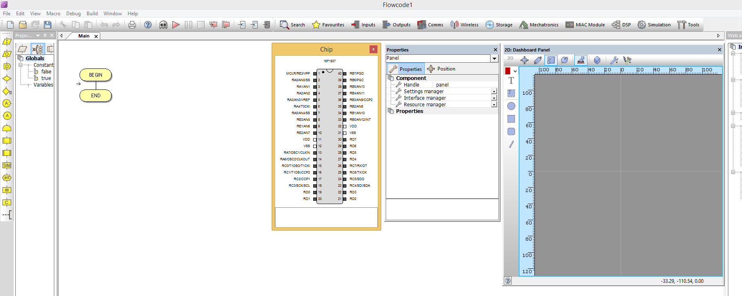
1
When you first load up Flowcode select New Project, this will then give you a list of options for which chip you want to programme for, the chip in my pic in my chip is a 16F1937 but you select whichever pic you have
This will start a new project for you, but whilst you’re here you want to make sure you have your chip visible (just for reference) as well as your 2D Dashboard panel as this is where you will be able to interact with all the simulated inputs and outputs you choose to put on your pic
  Bring up your 2D Dashboard panel by clicking on view and enabling it
2

Slide 3
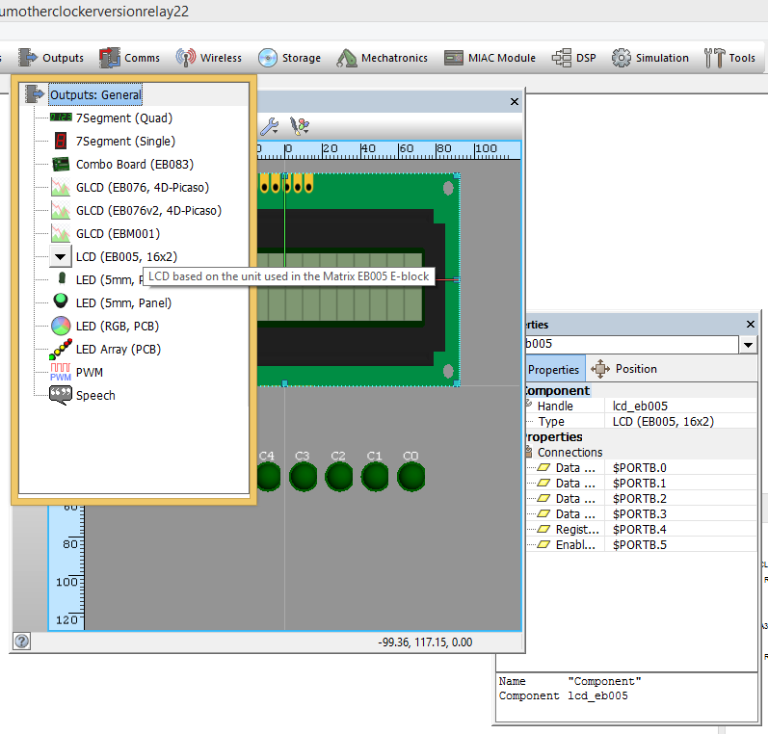
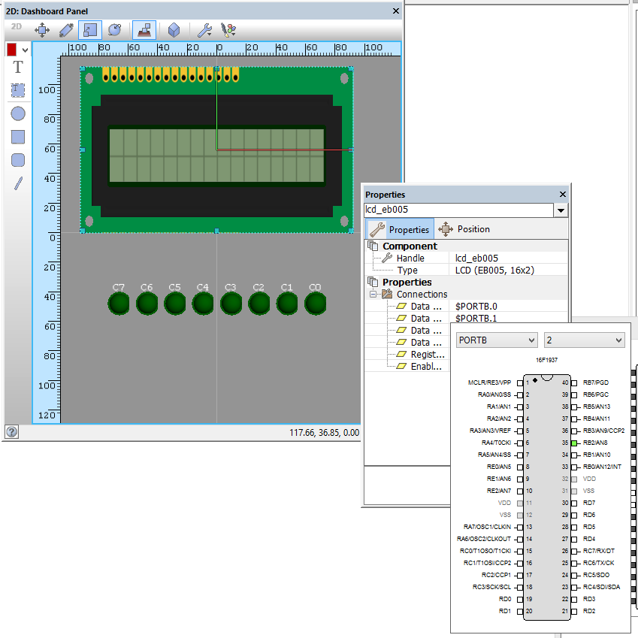
3
Select an LCD output for our timer to print on to by going to the outputs toggle on the top bar and clicking LCD. This will put an LCD in to our 2D Dashboard panel
Right click on the LCD to bring up the properties list and connect our LCD to PORTB
4

Slide 4
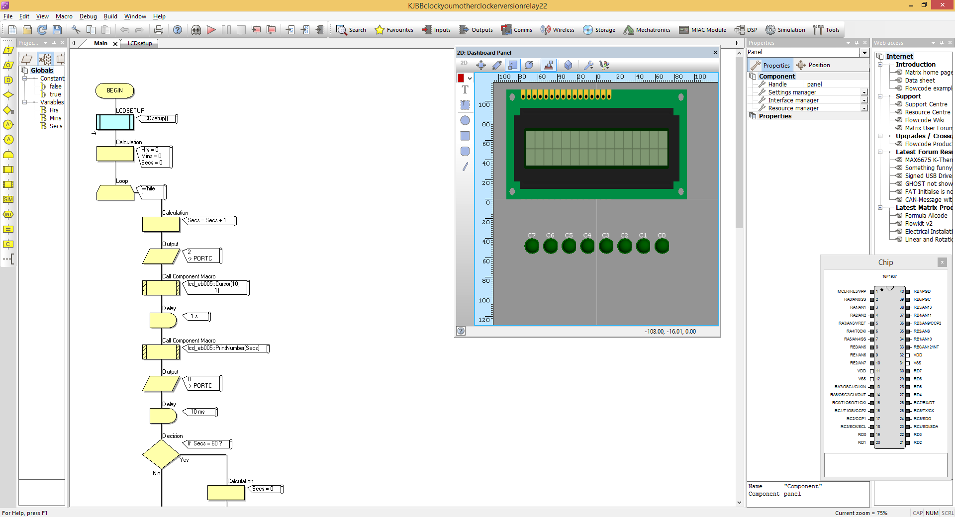
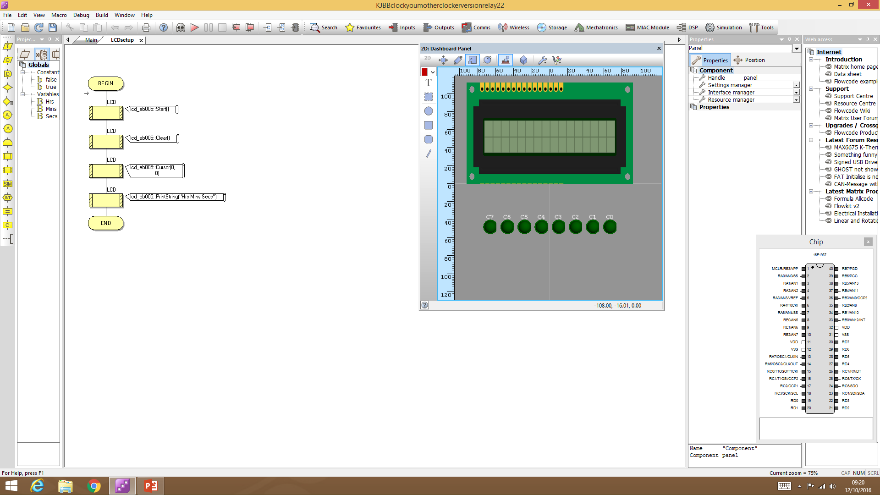
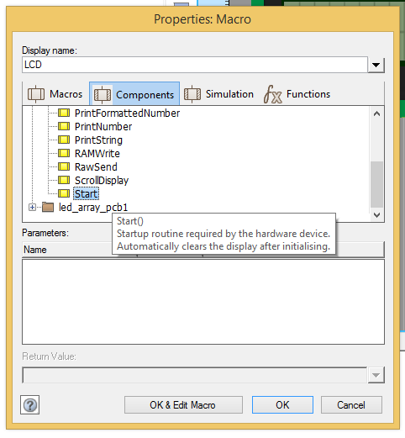

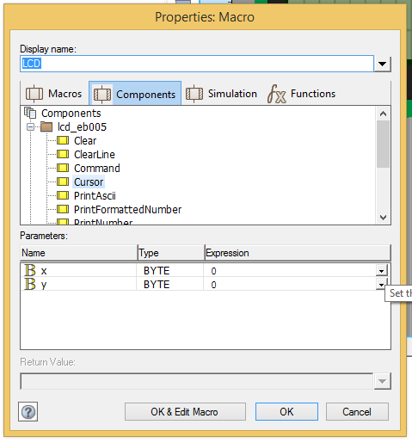
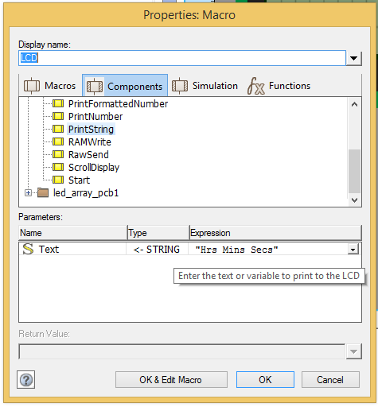
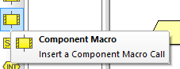
5
6
7
8
9
6

Slide 5
To make our programme less messy I put my code in a macro, but for simplicity sake you can just put the LCD setup straight in to our programme line by doing the following;
Insert a component Macro (on the side bar and drag it in to place between our ‘Begin’ and ‘End’ sequence. Double click on it and it should pop up a ‘Properties Macro’ box, on the list of components click the small plus sign next to LCD to expand the list, then select the ‘start’ command. Press okay and this is the component command that will start out LCD
Insert another component macro underneath and select the component this time as LCD ‘clear’, this erases anything that was previously on our LCD
Insert component macro underneath the previous one and select the component as LCD ‘cursor’, this will show parameters in the bottom that you can change, we want to set the x to 0 and the y to 0. This outlines where our numericals and letters will print on the LCD
Insert component macro underneath once again and select the component as LCD ‘print string’ in the parameters section we want to change our expression to ‘”Hrs Mins Secs”’, putting quotation marks (i.e. “ “) around the expression as seen in step nines image. This is our LCD top line set up and ready to use

Slide 6
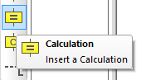
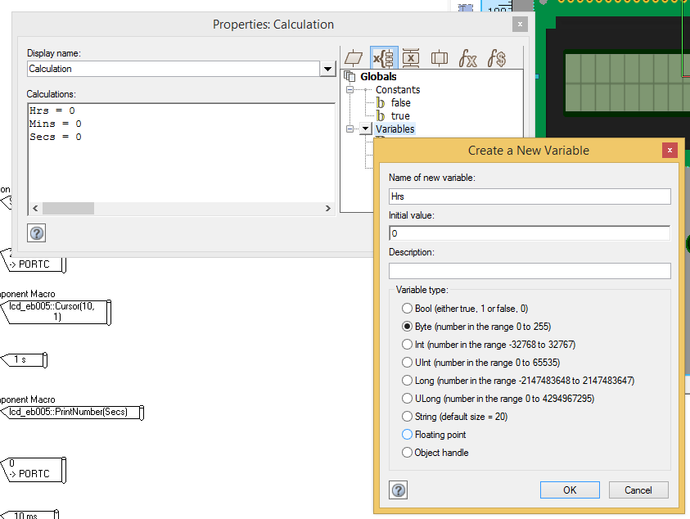
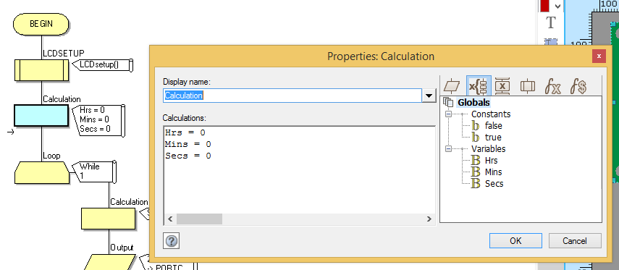
On the left hand side, drag a calculation underneath your LCD setup and double click to bring up the calculation properties. This is where we set it up so that the clock starts from zero.
We do this by making new ‘variables’ for each of Hrs, Mins and Secs. The initial value for each should be 0, click OK and set up the variables as illustrated in the red box in step 12
In the calculations box select your variable ‘Hrs’ and write ‘Hrs=0’, then press enter to get the line below and select your ‘Mins’ variable and write ‘Mins=0’, press enter to get the line below and then enter ‘Secs=0’ you want it as shown in the blue outlined box
10
12
11

Slide 7
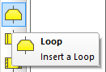
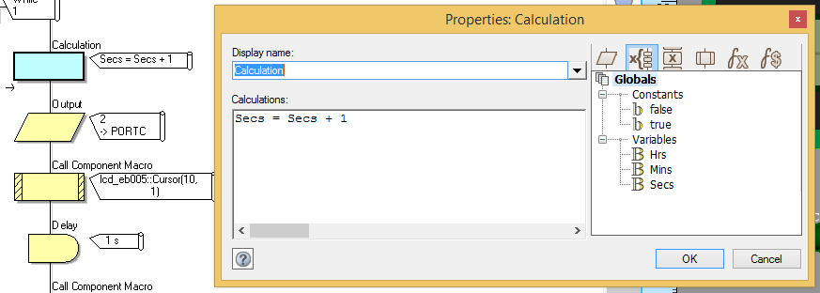
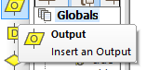
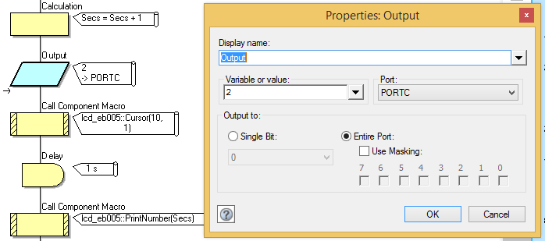
13
From the left side bar drag a loop in to your circuit underneath your previous work, this will make the clock continue clocking
Insert a calculation in to the loop that will count up our seconds by inserting in to the calculations box ‘Secs=Secs+1’
Drag an output box from the left side bar underneath your calculation, we’re going to set the output up to the relays we’re going to have attached to PORTC of our pic.
Clicking the output brings up the ‘Properties output’ and here we went to set out variable as 2 (this will turn on the second relay on our relay board, the click of the relay coming on and off will simulate the ticking of a clock every second
14
15
16

Slide 8
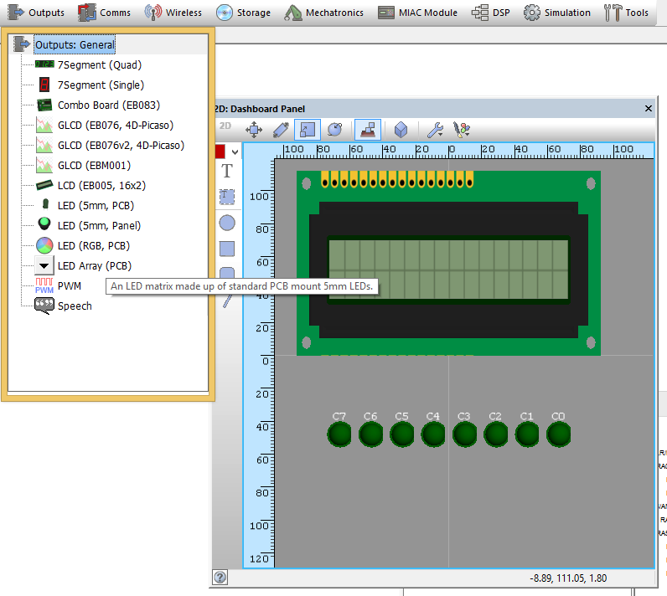
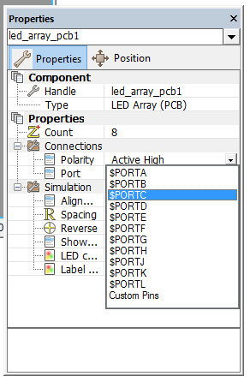
17. To simulate the relay board in our programme, insert an LED array output, making sure to go in to the properties menu and connect it to PORTC where our relays will be connected to our pic
17

Slide 9
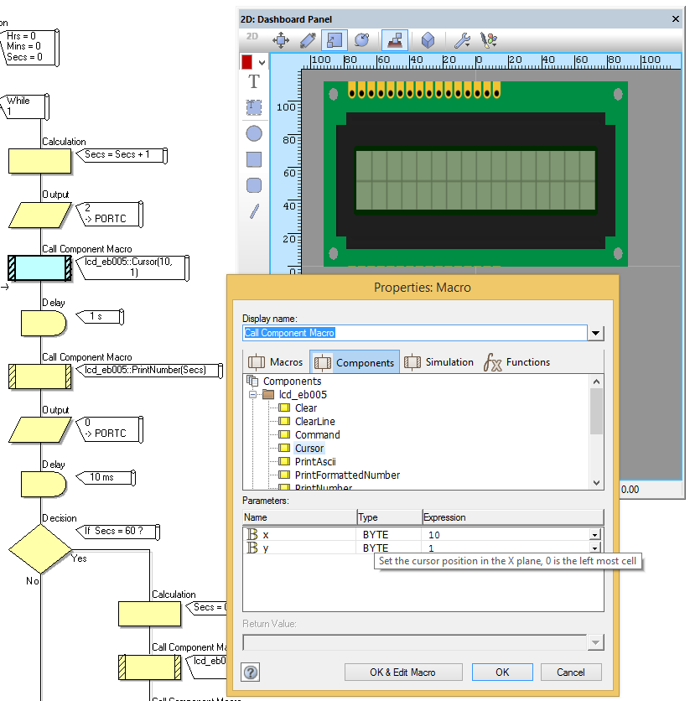
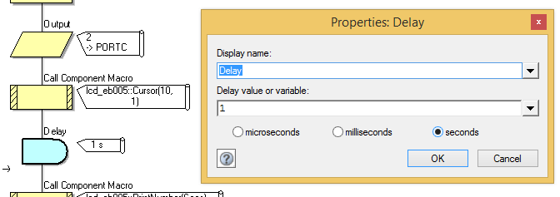
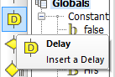
The next step is to display your counting seconds on the bottom line of your LCD display. You do this by inserting a component macro and setting the ‘cursor’ to 10 on the x axis and 1 on the y axis, this will display your counting seconds in the red boxes shown. My LCD display is 16 across and 2 down which is read from the top left hand corner as 0,0 and the bottom right hand corner as 15,1
Insert a delay from the left side bar underneath our LCD cursor, and double click it to bring up the properties. Set the delay value as 1 second. This will be our second timer.
18
(0,0)
X
Y
(10,1)
19

Slide 10
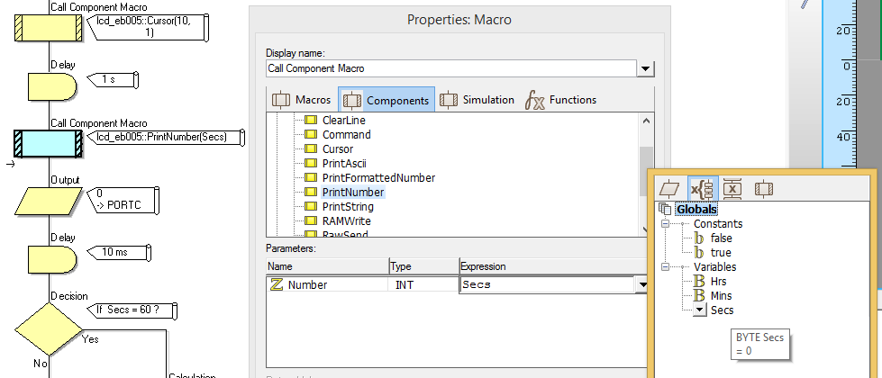

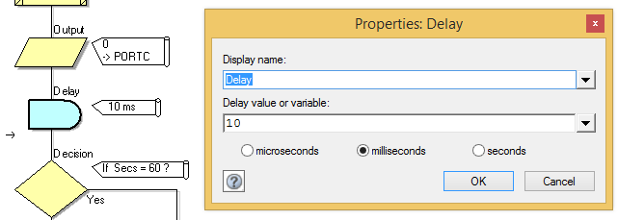
20
The next stage is to print our seconds on to the LCD, this is done by inserting a component macro, selecting ‘Print Number’ from the menu and setting our expression as ‘secs’
To turn the relay off in time ready for it to tick again at the next second, we put a 0 output to PORTC by inserting an output and setting the variable as 0
Now put in a delay of 10ms to allow the relay time to turn on and off in the circuit. Without a delay the off signal doesn’t have enough time to register in the circuit to turn off the relay. Do this by inserting a delay and setting the time properties as 10ms
21
22

Slide 11
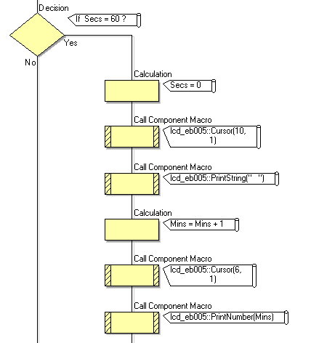

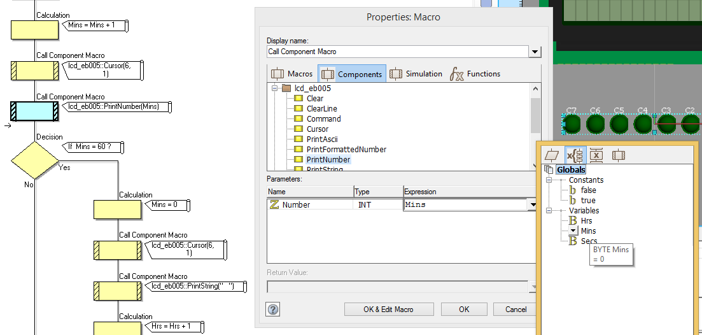
Time to make a decision so that when your seconds counter hits 60 it adds a minute to your clock and resets back to zero, this is done by inserting a decision and setting it for if ‘secs=60’
And then inserting the following within this decision;
  Inserting a calculation for secs=0
  Inserting a component macro on the LCD cursor in position (x:10, y:1)
  Inserting a component macro on the LCD that prints a string code of “ “ (so that it doesn’t print anything as it adds a minute)
  Insert a calculation now so that the minutes start counting: Mins=Mins+1
  Insert a component macro on the LCD cursor in position (x:6, y:1) this will count the minutes below where you set your Minutes read out on the LCD
  Insert a component macro on the LCD that prints the Minute number ←
  If you’re struggling to remember how to do the previous steps, go back and take a look at the previous stages which break it down a bit more
24
23

Slide 12
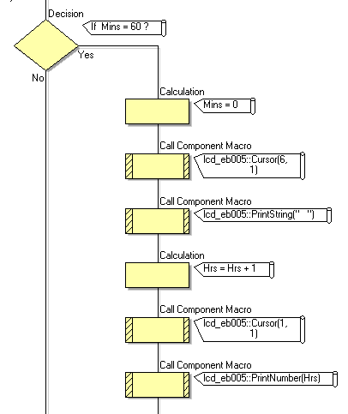
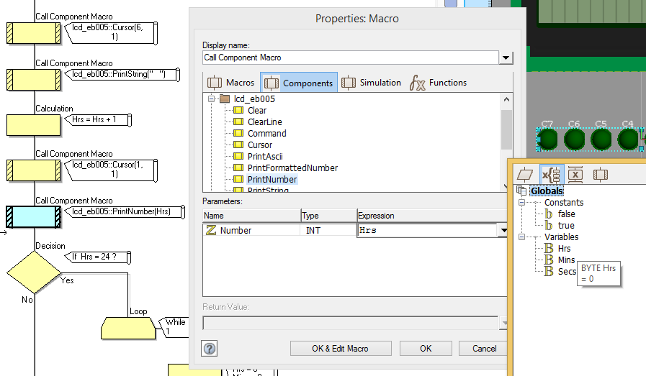
26
This stage is essentially the same as the last but modified to count minutes instead of seconds. Time to make a decision so that when your minutes counter hits 60 it adds an hour to your clock and resets back to zero, this is done by inserting a decision and setting it for if ‘mins=60’
Starting the counting of the hours can be done by
  Inserting a calculation for mins=0
  Inserting a component macro on the LCD cursor in position (x:6, y:1)
  Inserting a component macro on the LCD that prints a string code of “ “ (so that it doesn’t print anything as it adds an hour)
  Insert a calculation now so that the minutes start counting: Hrs=Hrs+1
  Insert a component macro on the LCD cursor in position (x:1, y:1) this will count the hours below where you set your Hours read out on the LCD
  Insert a component macro on the LCD that prints the Hours number ←
  If you’re struggling to remember how to do the previous steps, go back and take a look at the previous stages which break it down a bit more
25

Slide 13
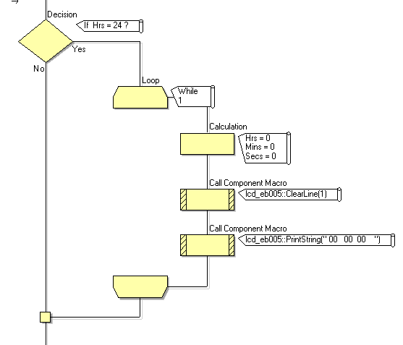
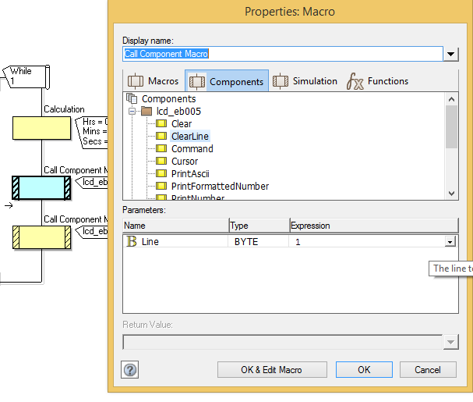
27
Now what happens once you’ve hit 24hrs? Well, I want my clock to return to zero and stay at zero (but you can easily modify this with a bit of ingenuity) as it is more of a 24hr timer than an actual clock. Insert a decision with the parameters that if ‘Hrs=24’
If you want a 24hr timer like mine then:
  Insert a loop that will make the circuit remain at 00:00:00 once it has passes 24 hours
  Within the loop put a calculation of Hrs=0, Mins=0 and Secs=0
  Insert a call component macro on the LCD that will clear the bottom line (Y:1) →
  Insert a call component macro on the LCD that prints a string of “00 00 00 “
    (That’s 00 space space space 00 space space 00 space space space)
28

Slide 14
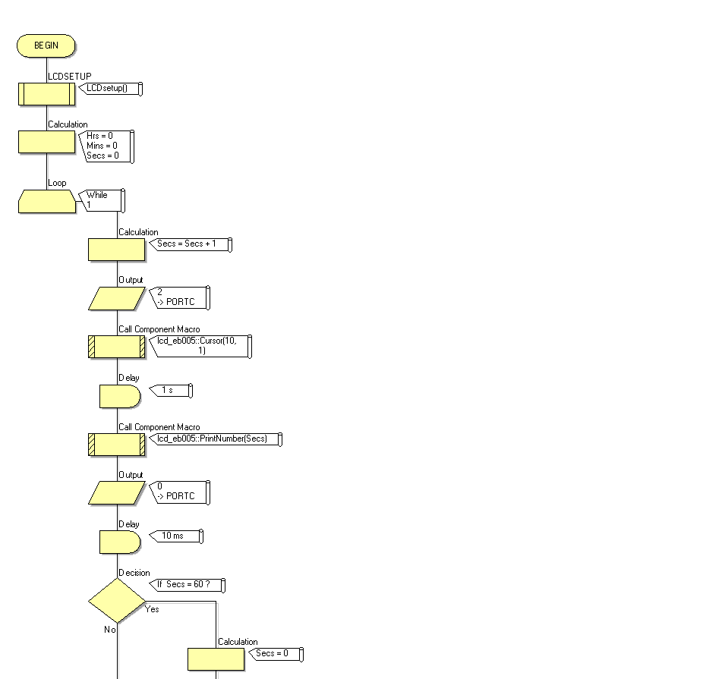
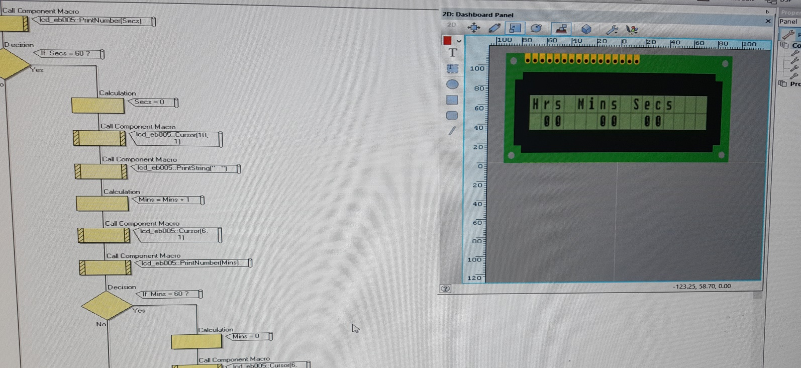


29. Now the best way to make sure your programme works is to run your simulation at every stage to see how it works. Here I’ve run it all the way through and after watching it count through 24hours it has gone to 0 as I have requested of it
29

Slide 15
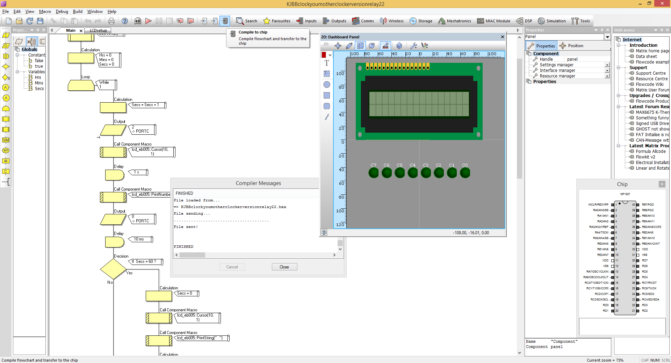
To get your written programme on to your chip plug your pic via USB cable in to your computer, and turn on your pic power supply , then click the button ‘Compile to chip’ which will pop up another window in Flowcode ‘compiler messages’ , wait for it to display that it has finished and it will have sent your programme to your chip and made your board fully functioning

Slide 16
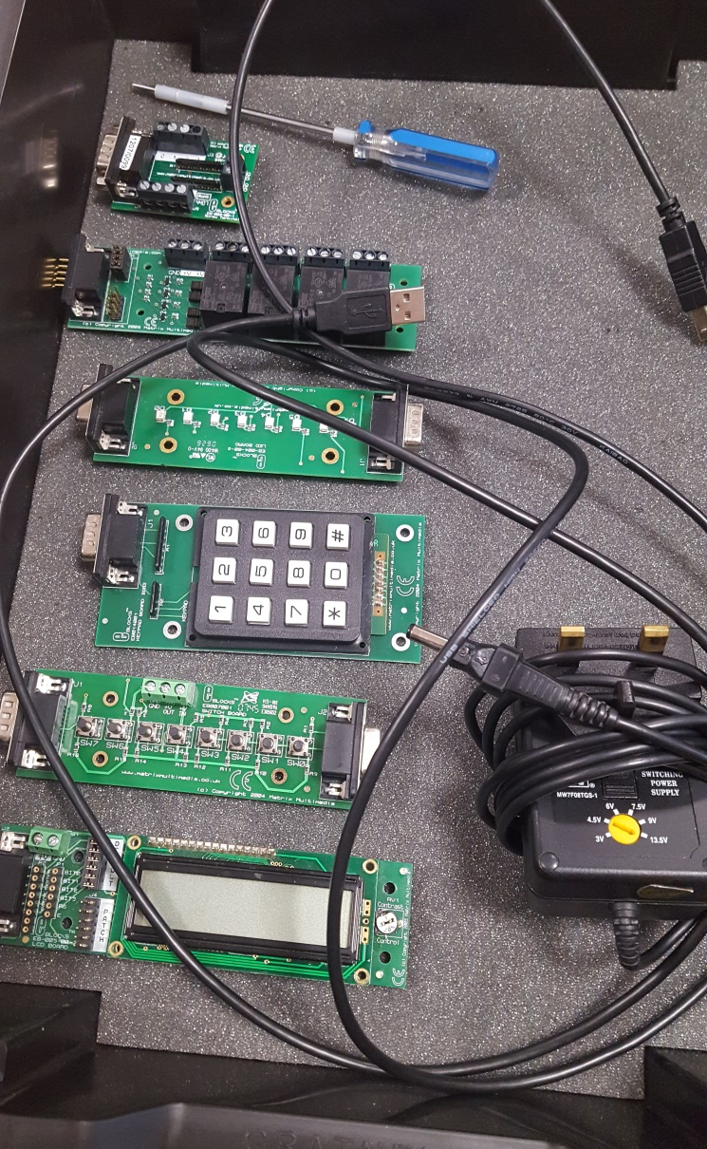
Components needed:
Screwdriver
USB cable (from PIC to USB, mine was a standard printer USB cable)
Power Supply Unit (to plug in to your PIC and give it power)
PIC Multiprogrammer
LCD Board
Relay Board
The components I’m using are all part of a Matrix set we were given to use at work and the PIC I’m using contains the 16F1937 microchip.

Slide 17
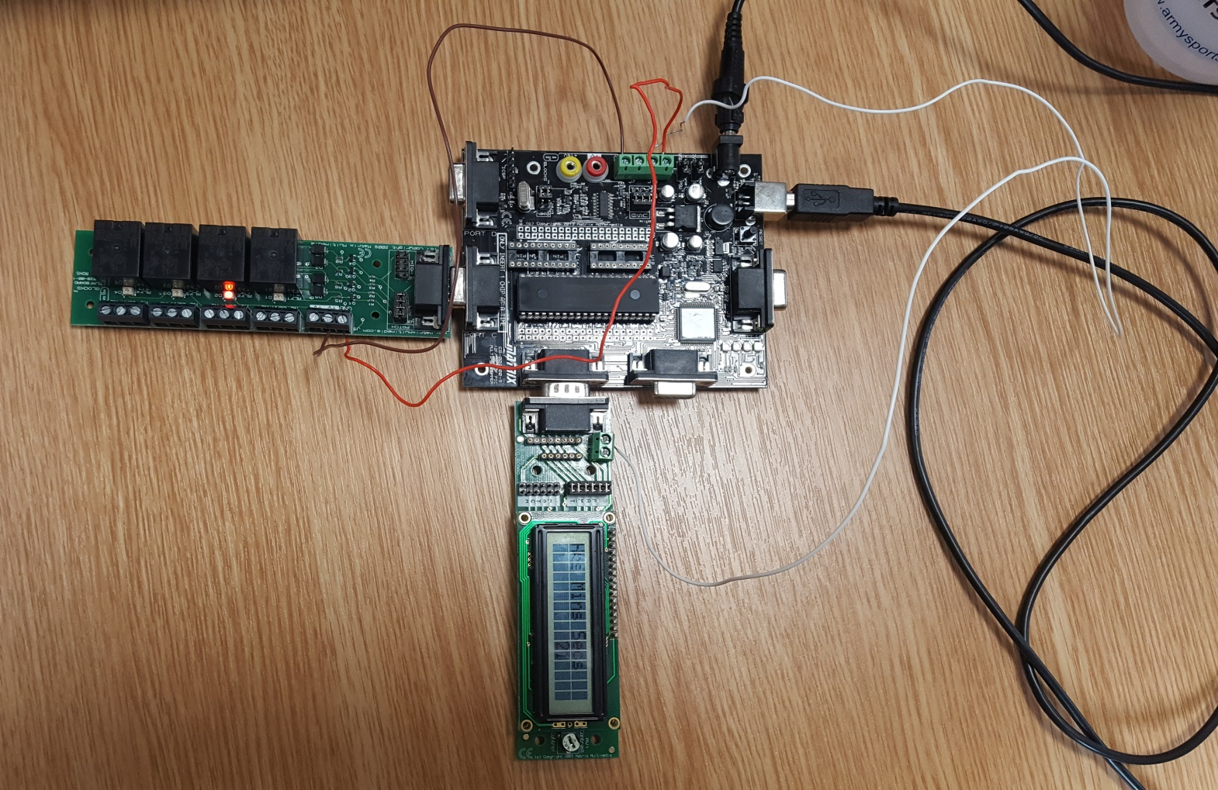
PSU
Assembling the PIC:
Start off by inserting your Relay Board in to PORTC
Now insert your LCD Board in to PORTB
Plug your PIC to USB cable in at both the computer end and the PIC end
Plug in your power supply unit
USB
PORTC
PORTB

Slide 18
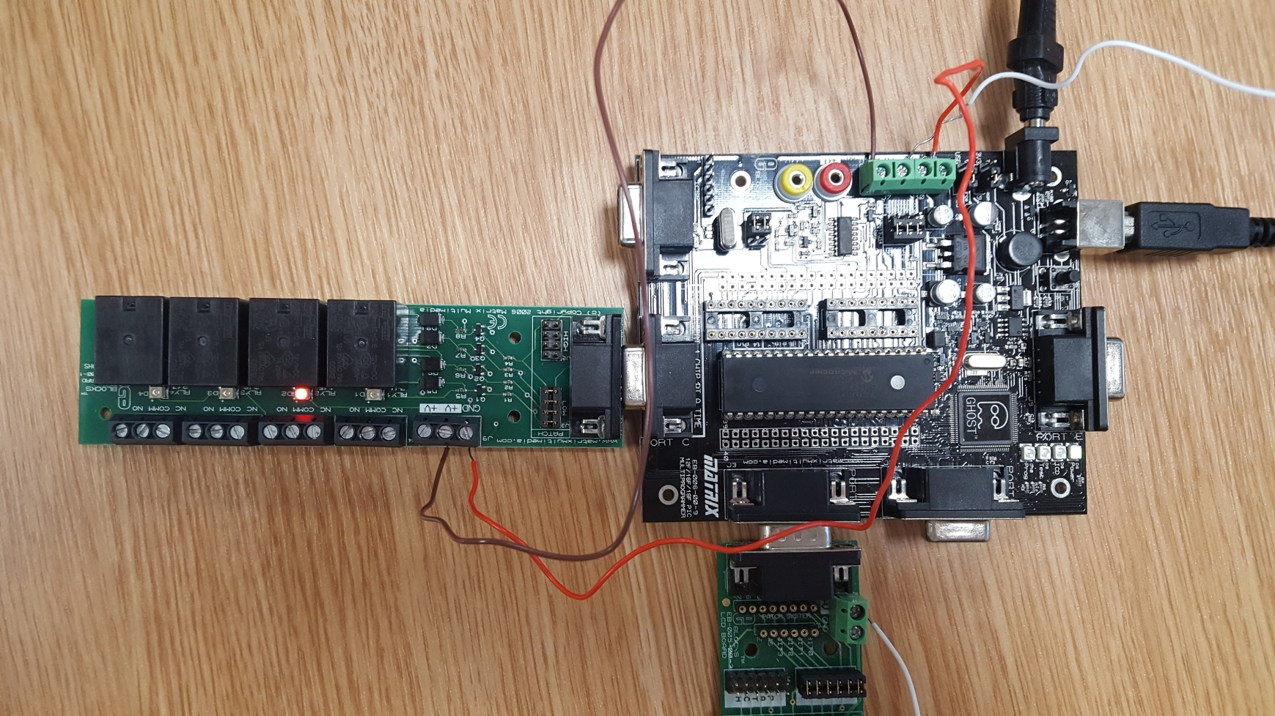
Wiring up the PIC using a screw driver to loosen and tighten the screws in the tops of the pins, it doesn’t really matter too much which type of electrical wire you use as long as it’s copper and is the right length (to illustrate where the wires connect I’ve gone over my picture with corresponding colour lines
Connect a wire from the +14V on your PIC to the +V on your Relay Board, this will supply power to your relays (see brown wire)
Connect a wire from GND (ground) on your PIC to GND on your Relay Board (see red wire)
Connect a wire from +V on your PIC to +V on your LCD Board (see white wire)

Slide 19
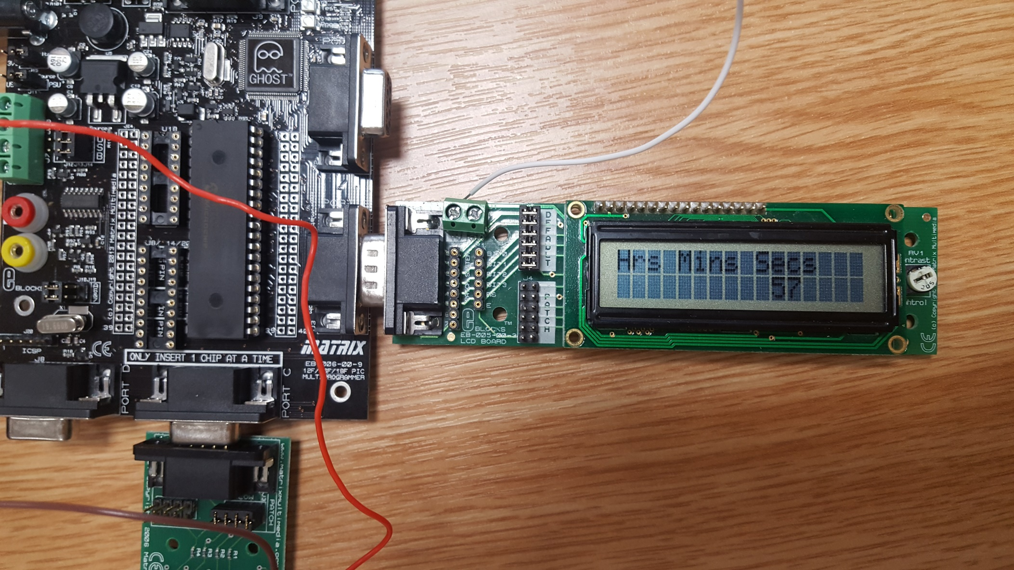
Once your PIC has been assembled and your programme put on to your chip have a play about, it should count seconds, minutes and hours perfectly as a 24hour timer and then set to 0 once it’s maxed out. Because of the relays mine now also ticks every second like a real clock! Fun project and a lot easier to do than I’d anticipated.

